Slide 1
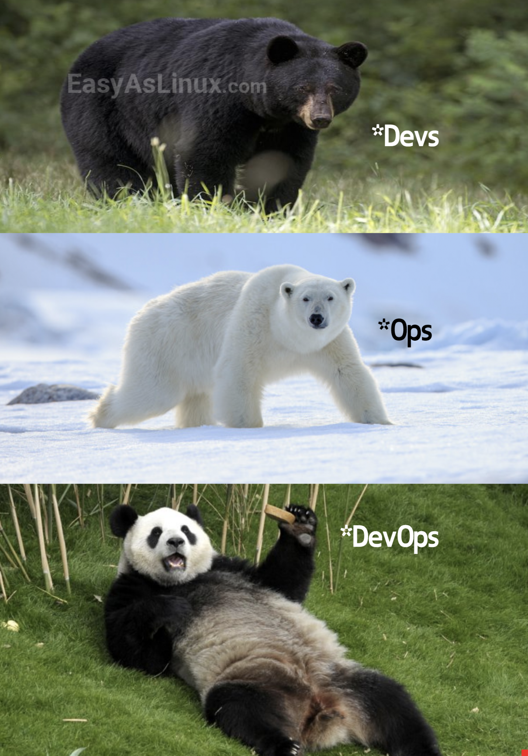
DevOps - Software Engineering
Roll Number(s):
S19-412 S19-205

Slide 2
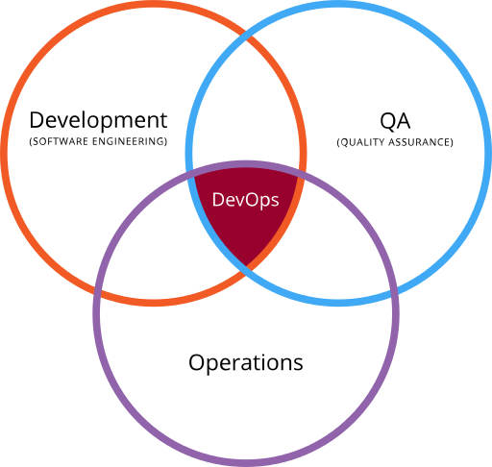
What is DevOps ?
The word DevOps is a combination of the terms development and operations, meant to represent a collaborative or shared approach to the tasks performed by a company's application development and IT operations teams.

Slide 3
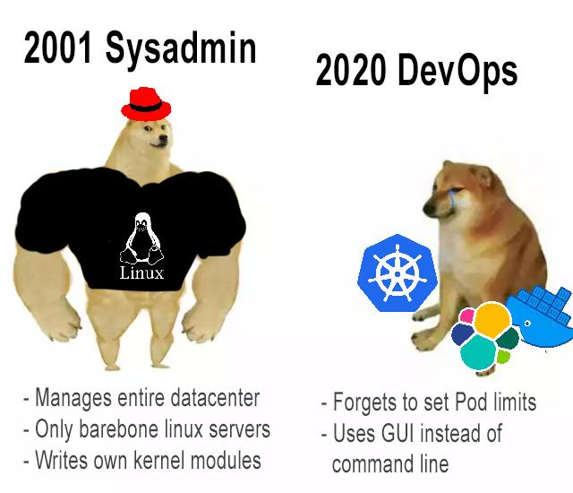
DevOps describes the adoption of iterative software development, automation and programmable infrastructure deployment and maintenance.
The term also covers culture changes, such as building trust and cohesion between developers and systems administrators and aligning technological projects to business requirements.
1

Slide 4
DevOps environments generally have common methodologies. These include the following:
Continuous Integration and Continuous Delivery or Continuous Deployment (CI/CD) tools, with an emphasis on task automation;
Products that support DevOps adoption, including real-time monitoring and incident management systems, configuration management and collaboration platforms;
Cloud Computing, Microservices and Containers implemented concurrently with DevOps methodologies.

Slide 5
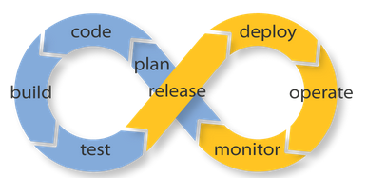
How does DevOps work?
You can visualize a DevOps process as an infinite loop, comprising these steps: plan, code, build, test, release, deploy, operate, monitor and -- through feedback -- plan, which resets the loop.

Slide 6
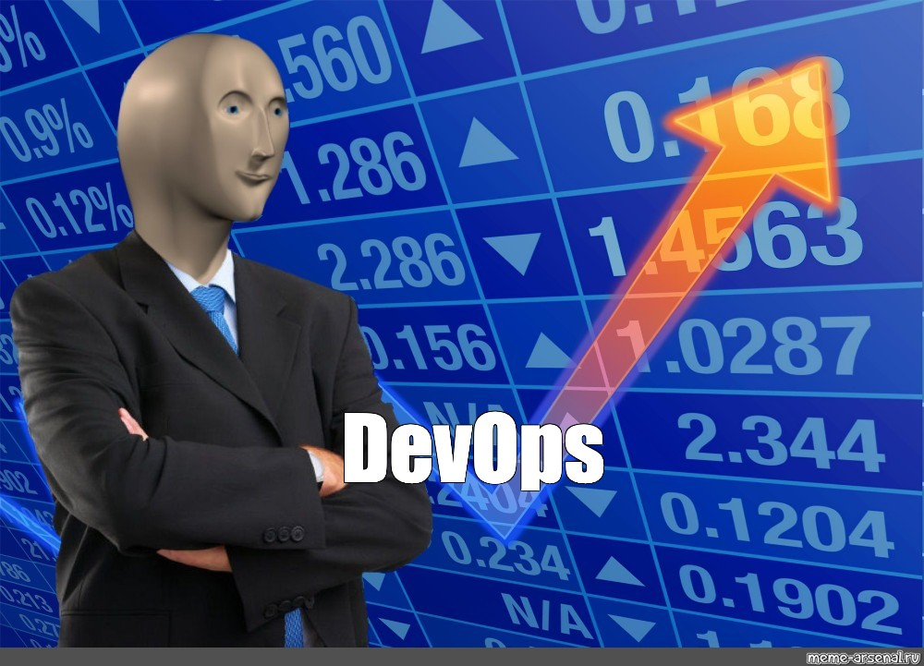
To align software to expectations, developers and stakeholders communicate about the project, and developers work on small updates that go live independently of each other.
To avoid wait times, IT teams use CI/CD pipelines and other automation to move code from one step of development and deployment to another.

Slide 7
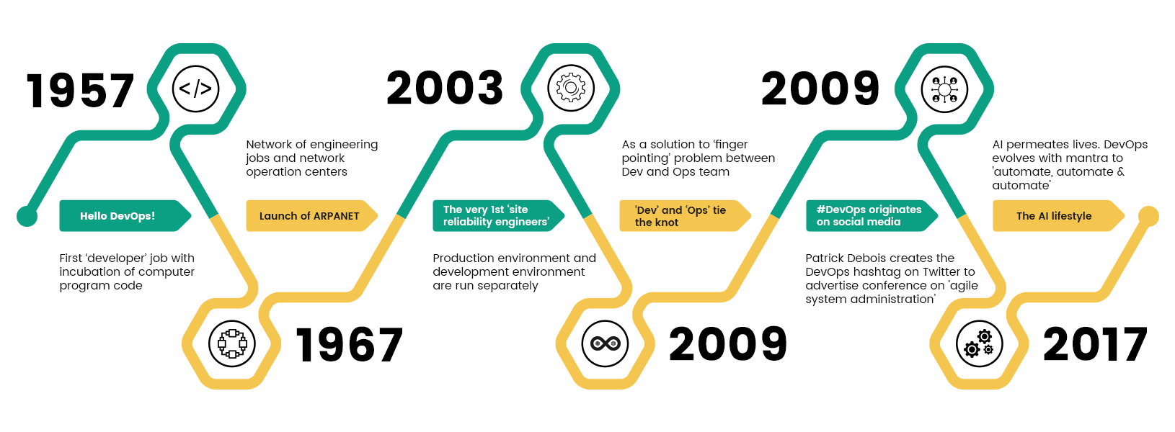
They deploy changes individually so that problems are traceable.
Teams rely on configuration management for consistent deployment and hosting environments.
Problems they discover in live operations lead to code improvements, often through a blameless port-mortem investigation and continuous feedback channels.

Slide 8
DevOps benefits and challenges:
DevOps benefits include the following:
fewer silos and increased communications between IT groups;
faster time to market for software;
rapid improvement based on feedback;
less downtime;
improvement to the whole software delivery pipeline through builds, validations and deployment;
less menial work, thanks to automation;
streamlined development processes through increased responsibility and code ownership in development; and
broader roles and skills.

Slide 9
However, DevOps challenges abound:
organizational and IT departmental changes, including new skills and job roles;
expensive tools and platforms, including training and support to use them effectively;
development and IT tool proliferation;
unnecessary, fragile or unsafe automation;
scaling DevOps across multiple projects and teams;
riskier deployment due to a fail-fast mentality and job generalization vs. specialization;
regulatory compliance, especially when role separation is required; and
new bottlenecks.

